Slide 1

The Bridge2Hope presentation to
American Women’s Club of The Hague
June 11th, 2020 via Zoom meeting

Slide 2


Mission
To serve as an anchor for survivors of human trafficking, empowering them towards economic, psychosocial, and spiritual freedom.

Slide 3
TheBridge2Hope – How it all started
The Bijlmer Project
  Collaborative project between Webster University & CARF (Christian Aid & Resources Foundation)
  Research-based program to investigate areas in need of psycho-social interventions for victims of human trafficking
  Development of a training and intervention module for peer educators (Commercial Sex Workers/trafficked victims rescued and rehabilitated) Bottom Up Approach
  Assisting CARF in capacity building to create and construct the Centre for Education & Rehabilitation for Women in Ghana
  Development of a systematic ‘drag & drop research and intervention model’ for victims of human trafficking across Webster’s Campuses

Slide 4
Research Objectives
Demographic variables
Assessment of psychosocial needs
Sexual health implications
Investigating Gaps in existing referral system: LEGAL & HEALTH

Slide 5
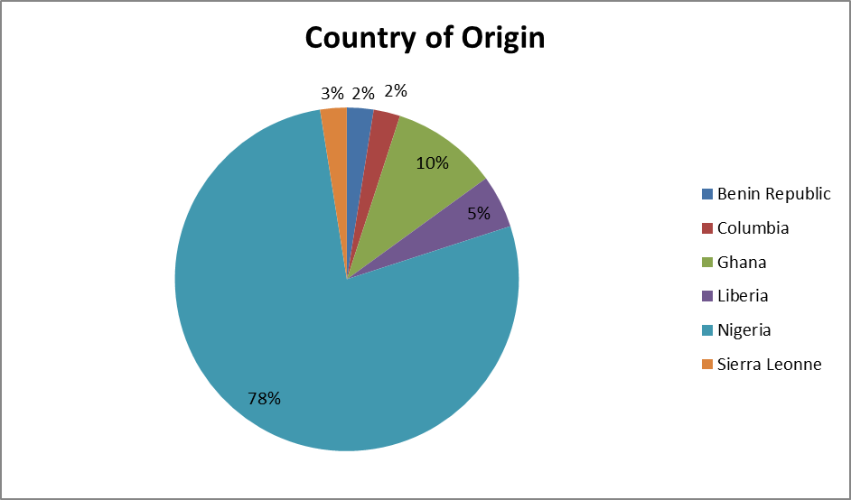
Country of Origin

Slide 6
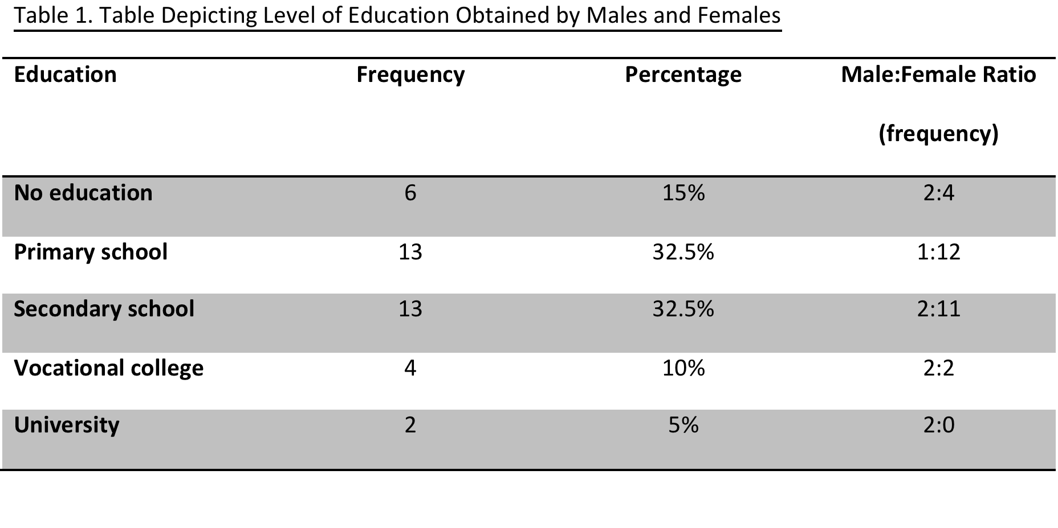
Education
The majority have completed some form of education
Mostly Primary and Secondary school

Slide 7
Occupation
“Not working”- some of the participants felt unable to share that they continue to engage in sex work.
No participants reported working in sex work in their country of origin

Slide 8
Sex and Age – over simplification of the “perfect victim”
The AGE of participants ranged from 21 to 57 with a mean of 38.5 years.
The mean age for men was 39.4 and the mean age for women was 38.27
Description of the ‘perfect victim’ has been stereotypically oversimplified
The perfect victim is someone who is young or minor (below 18), female, and from a developing country.
Consequences of such stereotyping in various situations can be detrimental to victims of trafficking and might lead to secondary victimization by authorities who work with victims of human trafficking
Vulnerability has NO age limit
Prevalence across cultures and across gender

Slide 9
Threats to Family
In the majority of the cases, this threat is ongoing (55.9%) and happens frequently, ranging from 1-2 times per month (13.8%) to more than 7 times per month (13.8%).

Slide 10
Threats to Self
Reported being beaten by their pimp or trafficker (77.5%)
Resulted in serious or moderate injury on (62.5%) of occasions
84% did not report injury to police
WHY: They were afraid(82.8%)
Their madam or pimp will harm them

Slide 11
Religion and Spirituality
Majority reported practicing a religion 97.5% claimed to practice Christianity
Reported being greatly influenced by their religion in their daily life 96%
95% of respondents believe in spirits, demons, or angels.
77.5% stated they believe in the existence of voodoo, majority 72.5% stated that they have had voodoo rituals performed on them
12 out of 29 participants reported that voodoo was performed on them in The Netherlands
60% reported that voodoo “greatly” affects their life

Slide 12
Current living situation
Most participants share a room 57.5% live in a place they call a home.
  Other living arrangements:
    Shelter 10%
    Brothel 2.5%
    “other”20%
Most would like to live in the Netherlands
    Safety 30%
    Freedom 10%
Majority stated they did not wish to return to their country of origin 80%

Slide 13
Post-Traumatic Stress Disorder (PTSD)
Symptoms
Response to items on a 4-point scale (ranging from 1[“not at all”] to 5 [“extremely”])
  Mean response for males was 4.19
  Mean response for females was 4.29
  Scores indicate a high level of PTSD symptoms
Mean of total PTSD scores is 71. 3 (maximum score=85)
No statistical difference between male and female scores(p=.700)

Slide 14
Understanding Psychological Coercion
Anatomy of THREATS and VIOLENCE
Research suggests that victims of human trafficking, in more contemporary times, experience a range of nonphysical coercive tactics like isolation, monopolization of perception, induced debility or exhaustion, threats, occasional indulgences, demonstration of omnipotence, degradation and enforcement of trivial demands (Baldwin et al., 2015)
Impact of this psychological coercion on the mental and physical health of trafficked victims has rarely been examined
Comorbidity with PTSD and substance abuse
Humanizing victims of Human Trafficking

Slide 15
Factors Sustaining Dependence
(Shah et al. 2018)

Slide 16
Psychological Dynamics: Shameful!
  “Out of shame I cannot tell my children what I did here. I have to cover it. Even right now I didn’t let my children know because the shame will be too much” (Interview 19)
  “People in Africa […]. Shame can’t go back. If no shame, I will go. Because you go back, you are not. Its like…. Where are you going to start from” (Interview 26)

Slide 17
Psychological Dynamics: Cynical and Impulsive
Some victims’ desperation has been observed to turn into a general cynical attitude about life altogether, resulting in weakened personal faith, and diminished trust in the authority and other people in general, including those who might be able to help or relieve some burden.
  “It makes me upset that I believe in God and my life is messed up, and I asking for something, and I don’t get it. So it just make me lost my faith. So, that was why I’ve just decided to be on my own. I don’t believe in anything” (Interview 4)
  “Because you don’t know who to trust. You keep to yourself everything as well. So, I don’t think these people will want to tell. And when you do tell the police, your family is in danger” (Interview 30)

Slide 18
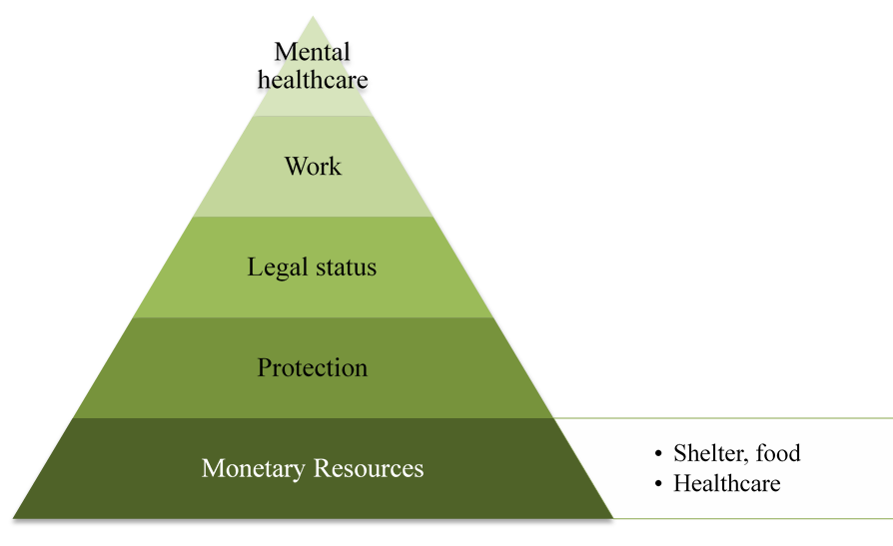
Actual Needs Post Pimp Stage (Shah et al. 2018)

Slide 19
Critical components of a sustainable Intervention Program
No Psychotherapy on an empty stomach!
Addressing Physical health: HIV AIDS and other STI’s
Understanding the survivors construct of their own ‘legal personality’ and providing legal support in a country specific manner
Customary understanding of the process of dehumanization: depersonalization and dissociation (Tsutsumi et al. 2008 & Vanwesenbeeck et al. 2005)
Addressing Economic Vulnerability through rehabilitation programs

Slide 20
TheBridge2Hope – For victims who have fallen between the cracks
What we stand for
Academy
Research
Advocacy
Support victims of human trafficking and (sexual) exploitation
to an economically independent live in dignity and take active part in society
1) Bottom up research and intervention based program to improve support and guidance to victims
2) Cooperation on international research into trafficking and exploitation to inventory trafficking (routes) and victims to enable focused approach and prevention
Create awareness,
start social debate and
ask for political attention
to generate a sustainable change in the appropriate approach, treatment and action of human trafficking and (sexual) exploitation

Slide 21
Focus on 1st pillar: The Academy
Vision - Mission - Values
Intervention and Support
Stabilisation
Rehabilitation
Re-integration
Physical, Psychosocial and
Medical support
Nutrition program
Dutch lessons
Basic math
Computer lessons
Vocational training
Cultural and Social skills
Language training
Professional education
Financial Independence
Legal support when needed
Project
TheBridge2Hope Academy
Alumni Support
Research
Advocacy
Funding
MarCom
Volunteers
Fundamentals

Slide 22
Objective B2H - Academy
2020 - 2022
Support 30 survivors of human trafficking and (sexual) exploitation on a yearly basis, empowering them towards economic, psychosocial, and spiritual freedom, starting in Amsterdam Zuid Oost

Slide 23
Strategy B2H Academy
2020 - 2022
Become a professional and sustainable NGO (current foundation started in August 2018)
  Become a financial sustainable organization
  Embed B2H in Dutch NGO landscape
  Expand The Bridge2Hope Academy
  Professional organizational and governance and organizational structure: BoD, Executive MT and Volunteers
  Communicate in a clear and transparent way to all stakeholders

Slide 24
Expand TheBridge2Hope - Academy
Recruit, support and train 5 cohorts of 6 participants on a yearly basis (including Alumni)
Provide a support program (curriculum) of 2 days per week per cohort
Have a professional base of volunteers for project coordination, training and support
Monitor and evaluate the progress of the Academy

Slide 25
How the FAWCO grant will be used
Focus on stabilization: providing physical, psychosocial and medical support.
  In this phase we focus on gaining trust and dealing with the impact of psychosocial traumas by creating a safe space in the field
Activities:
  Psychosocial care per participant per year $ 1,500
  Social cultural and vocational training per cohort for one year $ 2,000
  Cost for food and nutritional program per cohort for one year $ 1,500
  “No psycho-social therapy on an empty stomach”

Slide 26
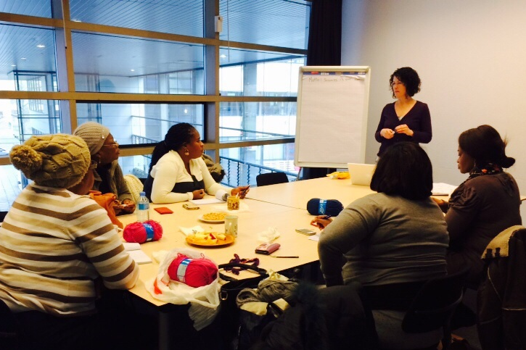
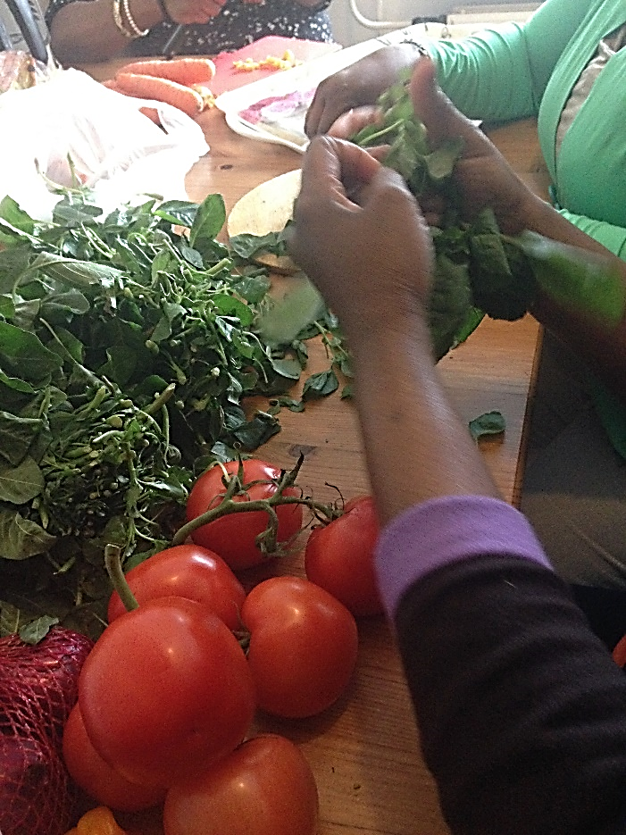
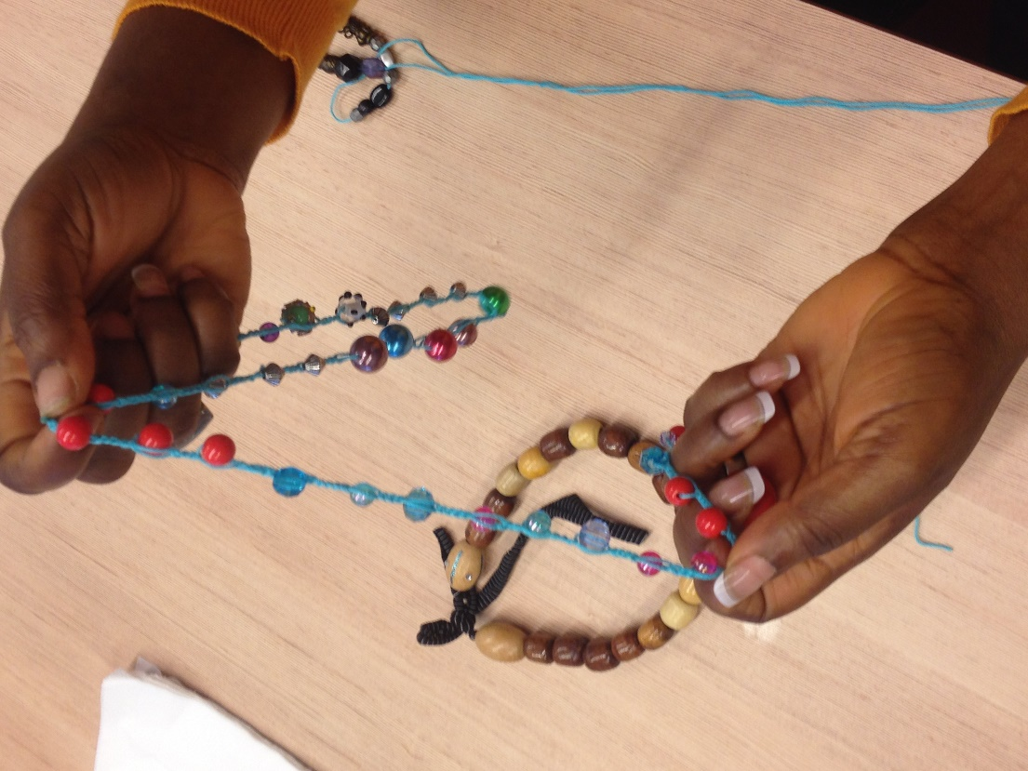
We teach them about healthy food, how to cook and create jewelry
While these activities are great for stress-management, they could also lead to future jobs or businesses – a way for the women to be financially stable

Slide 27

Thank you for your donation
We value:
Compassion
Shared Leadership
Creativity
Entrepreneurship
Inclusiveness
Sustainability

