Slide 1
Federal Benefits Units (FBUs)
Located in United States embassies and consulates at 21 locations around the world.
FBUs are sometimes called Claims Taking Posts (CTPs).
The people who work in the FBUs are Department of State employees.
FBUs provide services outside of the United States for these agencies:
  Social Security Administration (SSA) 92%
  Veterans’ Affairs (VA) 3%
  Office of Personnel Management (OPM) 3%
  Department of Labor (DOL) 1%
  Railroad Retirement Board (RRB) 1%

Slide 2
FBU Services
FBUs provide a broad range of services, such as:
  Providing information to applicants about benefits
  Providing necessary forms
  Assisting applicants with completing forms
  Taking and developing benefit claims
  Arranging medical appointments for disability claims
  Following up with agencies when necessary
  Processing benefit entitlement changes (i.e., address, direct deposit, reports of death, etc.)
  Processing applications for Social Security Numbers

Slide 3
Non-Claims Taking Posts (NCTPs)
Embassies and consulates without a Federal Benefits Unit are called Non-Claims Taking Posts (NCTPs). They work closely with an FBU and can provide limited federal benefits assistance, such as:
  Accepting Social Security Number applications
  Establishing an applicant’s “Intent to File” and forwarding it to the servicing FBU
  Handling inquiries for other federal agencies
  Accepting reports of changes (i.e., address, direct deposit, deaths, marriages, etc.)
  Assist FBUs with medical appointments for disability claims
  Providing assistance to FBU’s for field investigations and beneficiary contact

Slide 4

Canada
Social Security service to Canada is provided by the US Social Security offices in the states that border Canada (Alaska, Washington, Idaho, Montana, North Dakota, Minnesota, Michigan, New York, Vermont, Maine)

Slide 5
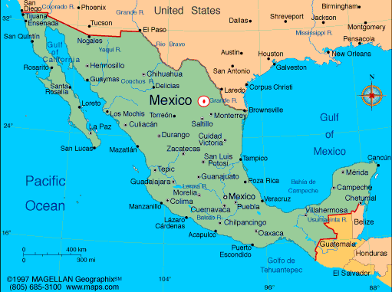
Mexico City Region FBUs
Ciudad Juarez
Guadalajara
Mexico City

Slide 6
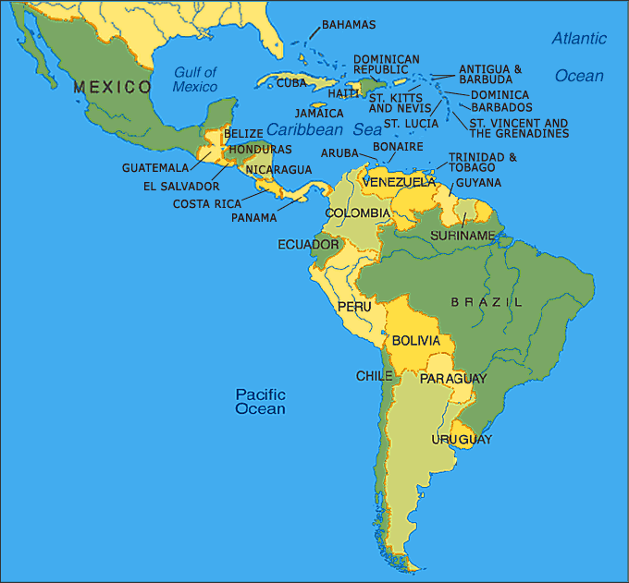
San Jose Region FBUs
Santo Domingo
San Jose
Buenos Aires

Slide 7
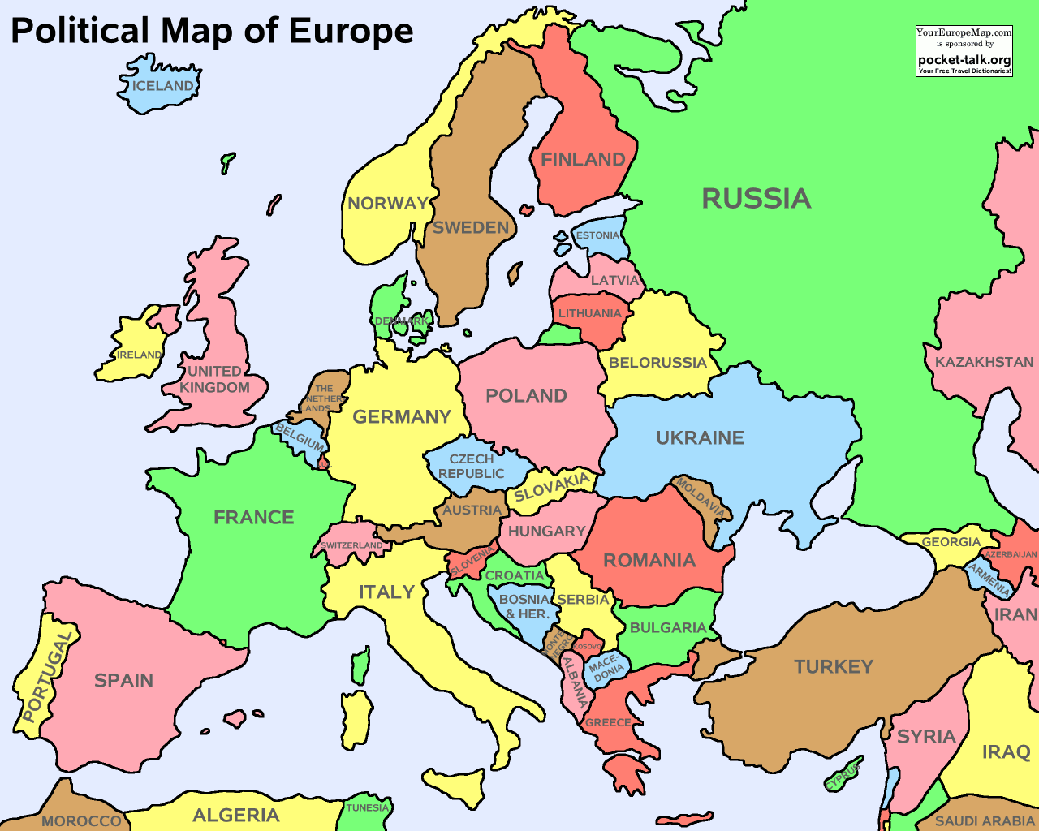
London Region FBUs
Oslo
Dublin
London
Lisbon
Madrid

Slide 8
Frankfurt Region FBUs
Warsaw
Frankfurt
Krakow
Paris

Slide 9
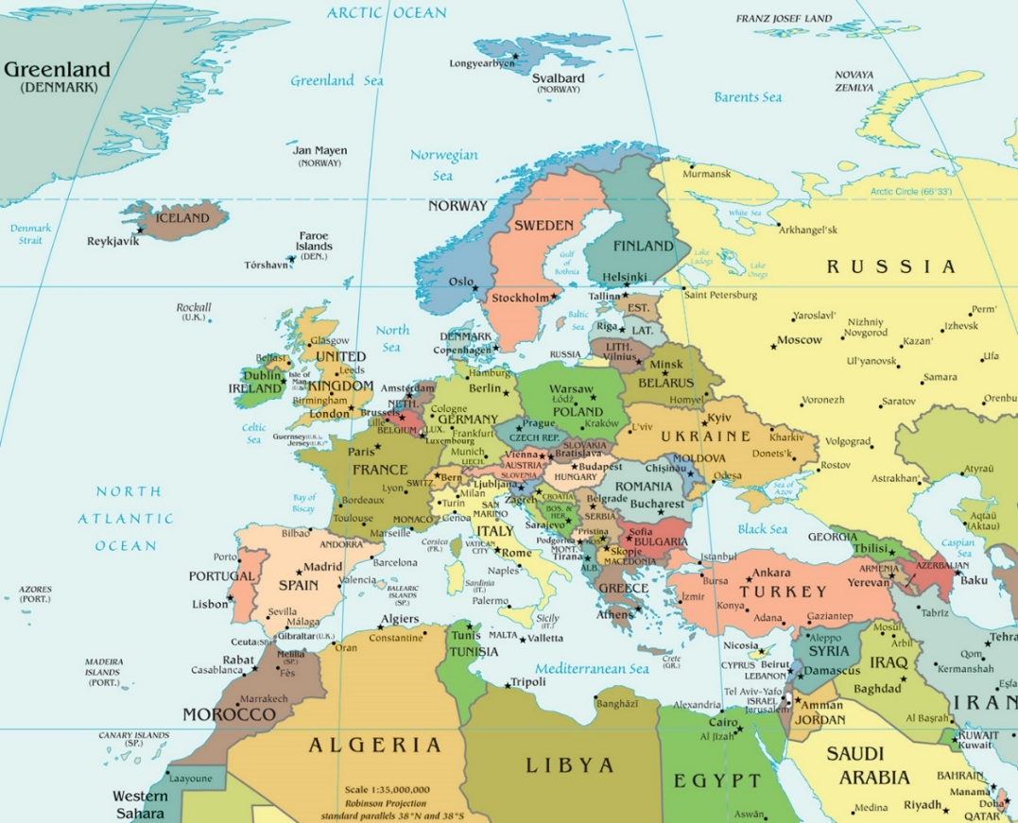
Rome Region FBUs
Rome
Naples
Athens
Jerusalem

Slide 10
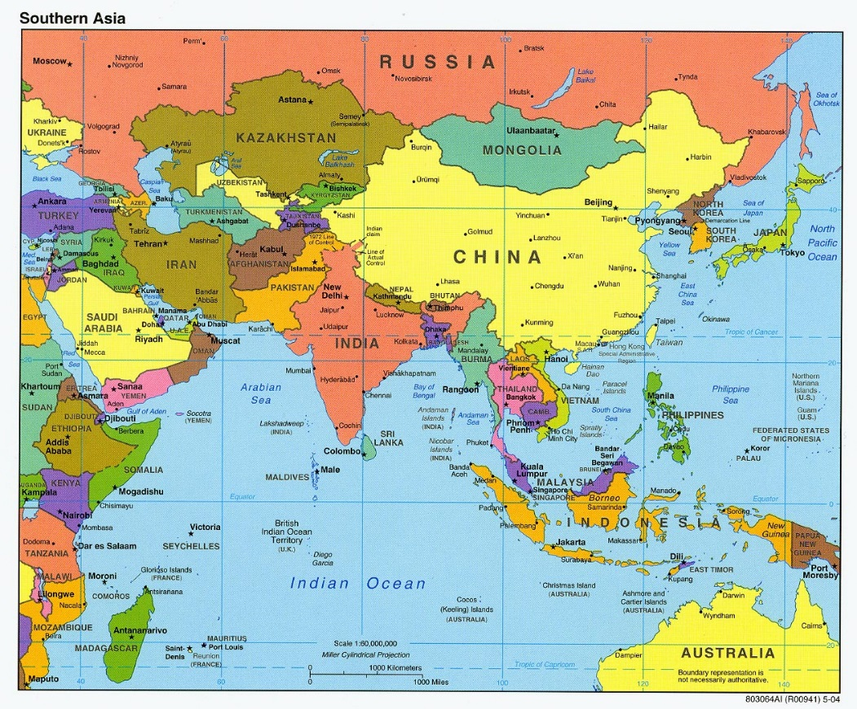
Manila Region FBUs
Tokyo
Manila

Slide 11
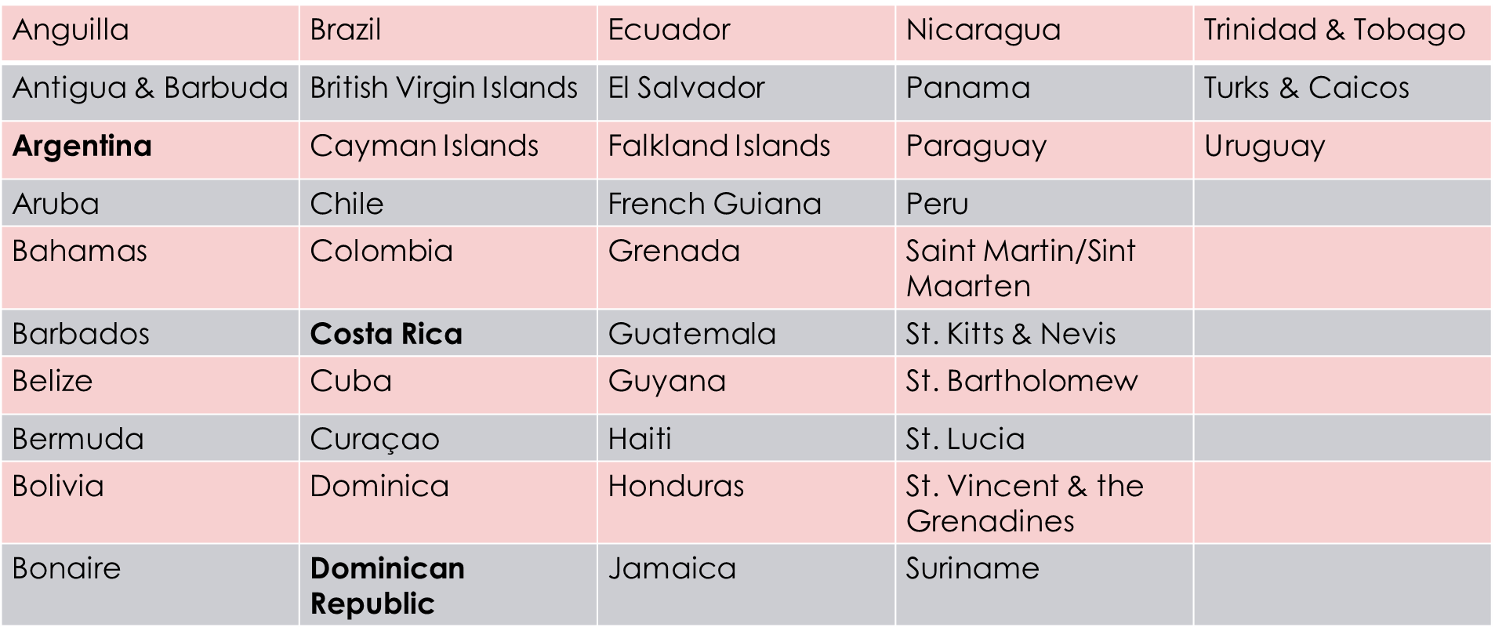
Countries Served by San Jose Region FBUs
Venezuela

Slide 12
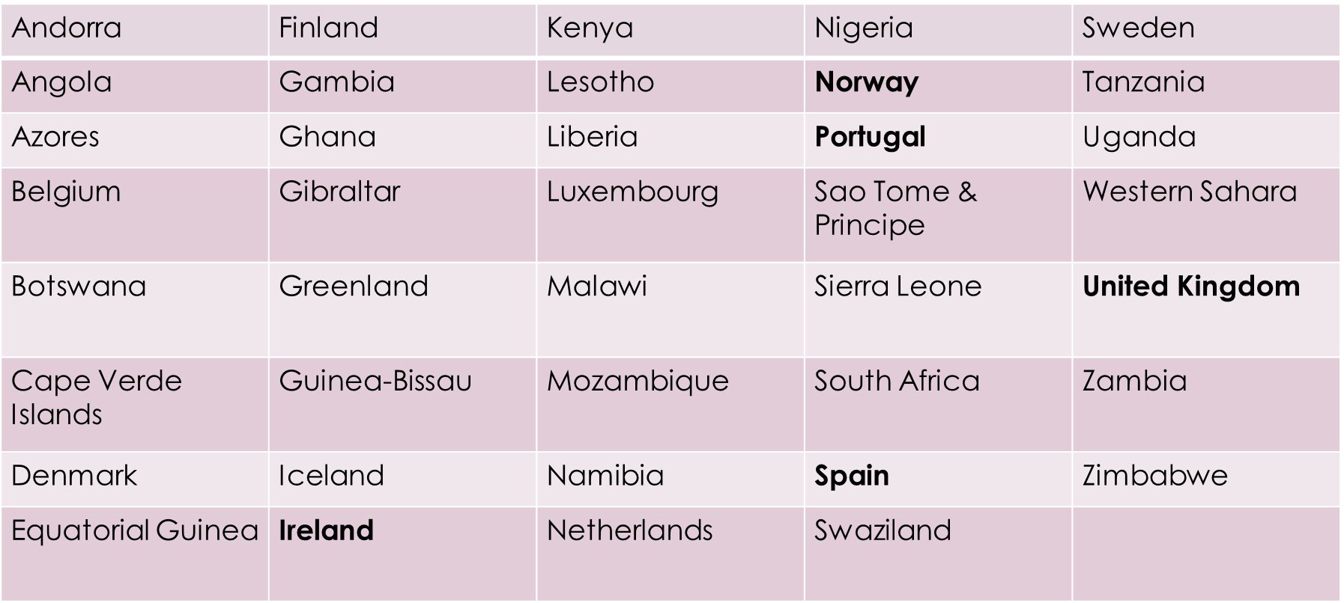
Countries Served by London Region FBUs

Slide 13
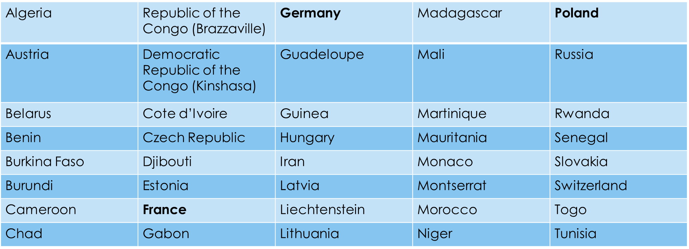

Countries Served by Frankfurt Region FBUs

Slide 14
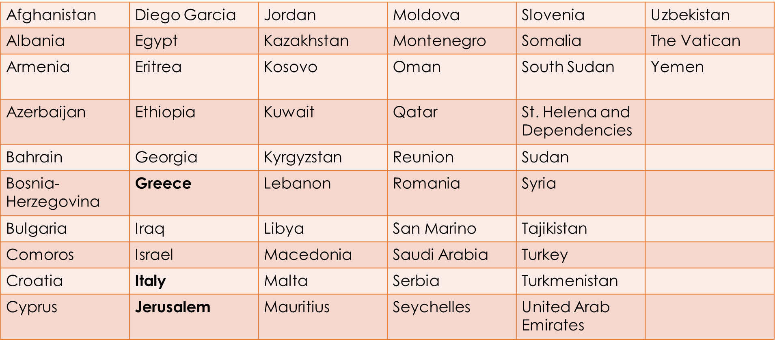
Countries Served by Rome Region FBUs

Slide 15
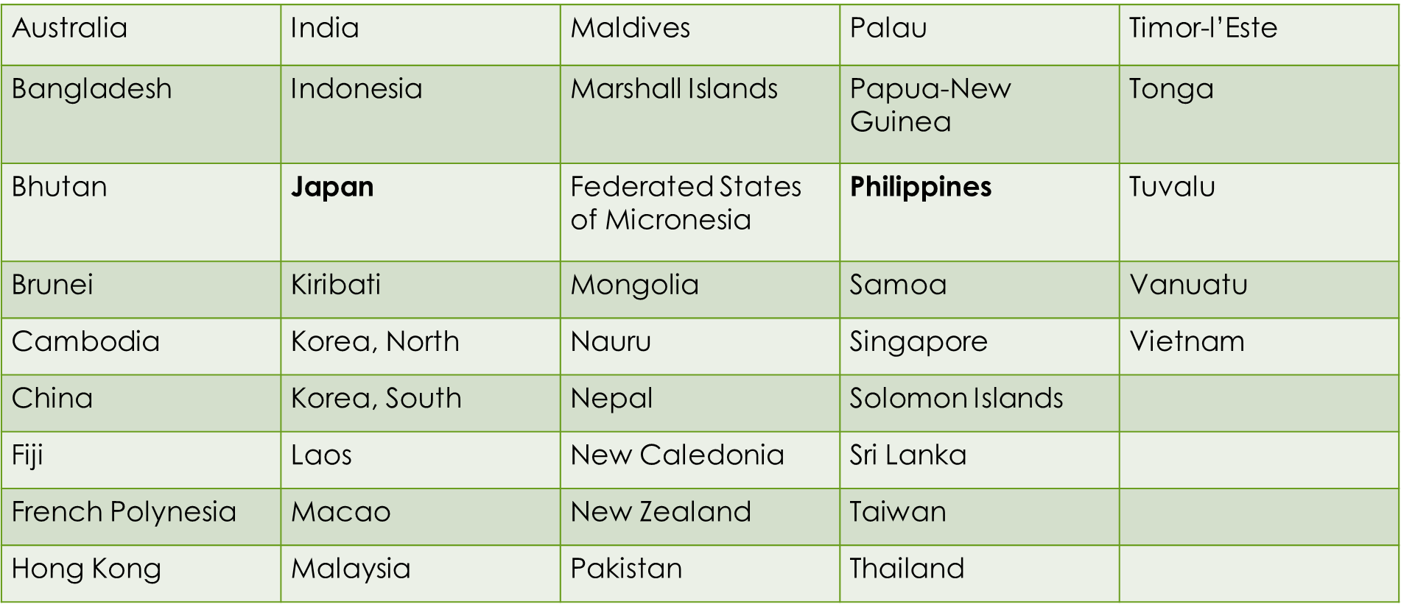
Countries Served by Manila Region FBUs

Slide 16
Which FBU Serves My Country?
https://www.ssa.gov/foreign/foreign.htm
Mexico City Region San Jose Region
FBU.Mexico.City@ssa.gov FBU.CostaRica@ssa.gov
FBU.Ciudad.Juarez@ssa.gov FBU.Argentina@ssa.gov
FBU.Guadalajara@ssa.gov FBU.SantoDomingo@ssa.gov

Slide 17
Which FBU Serves My Country?
London Region Frankfurt Region
FBU.London@ssa.gov FBU.Frankfurt@ssa.gov
FBU.Dublin@ssa.gov FBU.Paris@ssa.gov
FBU.Lisbon@ssa.gov FBU.Krakow@ssa.gov
FBU.Madrid@ssa.gov FBU.Warsaw@ssa.gov
FBU.Oslo@ssa.gov

Slide 18
Which FBU Serves My Country?
Rome Region Manila Region
FBU.Rome@ssa.gov FBU.Manila@ssa.gov
FBU.Naples@ssa.gov FBU.Tokyo@ssa.gov
FBU.Athens@ssa.gov
FBU.Jerusalem@ssa.gov

